Slide 1
Sequential File
Programming 512
Prog512, chapter 2, page 25 in the study guide
Mr N. Mathenjwa

Slide 2
Learning Objectives
How to Open a Text File in VB .NET
Reading Data from an Existing File
Create and Write to a Sequential File
Appending or Adding Data into an Existing File
Classes File and Directory

Slide 3
Introduction
VB.NET provides multiple ways to save program data out to a file. This topic will walk you through several different ways to easily save your data to a simple text file. This is by far the most straight forward way to serialize data so that your VB program can later read it back in.
Below you will learn how to write to files using both a fixed format and a delaminated format. If you don’t know what this means or why you would choose one over the other please read on the next two topics and it will make sense.
The ability to open up a text file and read its contents can be very useful to you in your programming life. You might have a text file containing quiz questions and answers, for example. You could read the questions and answers from a text file and create your own "Who wants to be a Millionaire" game.

Slide 4
How to Open and Read From Text File
To open a file you have to first import the input output class
Imports System.IO
Create a stream reader object that you going to use to operate on a file,it has all the necessary functions to operate on a file such as openText, CreateText etc…
Dim objReader As StreamReader
Use the function openText of the StreamReader object to open the file
objReader = IO.File.OpenText(“filedirector/fineName.txt")
Can display the contents of a file using massage box, list box or any output control available in vb by using the function ReadLine.
MsgBox(objReader.ReadLine)

Slide 5
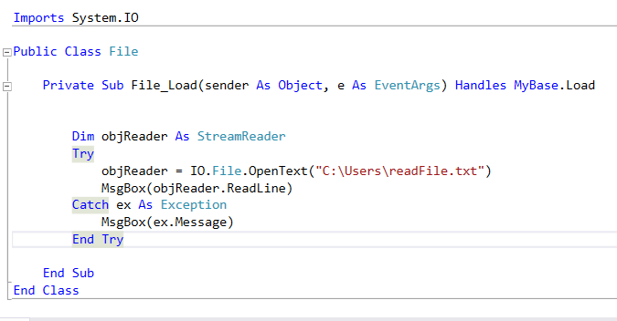
How to Open a Text File in VB .NET

Slide 6
Create and Write to a Sequential File
To create a file you have to first import the input output class
Imports System.IO
Create a stream writer object that you going to use to operate on a file, it has all the necessary functions to operate on a file such as openText, CreateText etc…
Dim objReader As CreateText
Use the function CreateText of the StreamWriter object to create the file
objWriter = IO.File.CreateText(“fileDirectory/fileName.txt“
Use the function WriteLine to write into a text file
objWriter.WriteLine(" This is where you put the text content of the file")
Don’t forget to close the file after use so to allow other programs to use it
objWriter.Close()

Slide 7
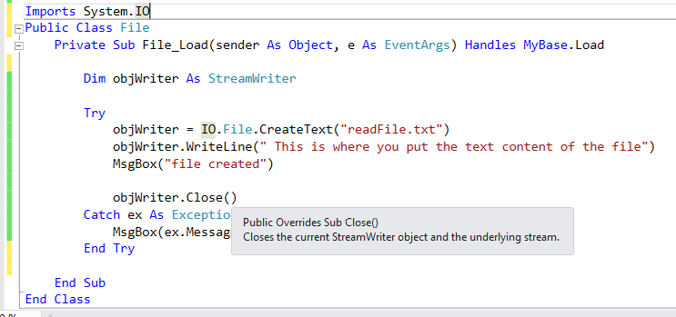
Create and Write to a Sequential File

Slide 8
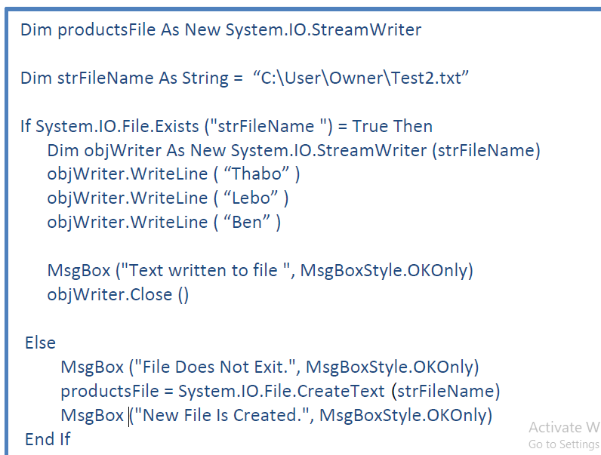
Create and Write to a Sequential File
Example:
Create a stream writer
Use this statement to check if the file already exists
Writing into a file
Closing a text file
If the file doesn’t exists
Display massage
Create the new file

Slide 9
Appending or Adding Data into an Existing File
There will be times when you won't want to erase all the text from your file. You'll only want to add text to what you currently have. In which case you need to Append. Appending text to your file is quite easy.
To append into a file you have to first import the input output class
Imports System.IO
Create a stream writer object that you going to use to append on a file.
Dim objWriter As StreamWriter
Use the function append Text of the Stream Writer object to append into the file
objWriter = IO.File.ApendText(“fileDirectory/fileName.txt“
Use the function WriteLine to write into a text file
objWriter.WriteLine(" This is where you put the text content of the file")
Don’t forget to close the file after use so to allow other programs to use it
objWriter.Close()

Slide 10
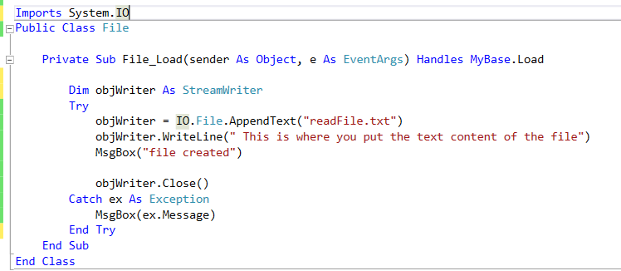
Appending or Adding Data into an Existing File

Slide 11
Classes File and Directory
Information on computers is stored in files, which are organized in directories. Class File is provided for manipulating files, and class Directory is provided for manipulating directories. Class File cannot write to or read from files directly; we discuss methods for reading and writing files in the following sections.

Slide 12
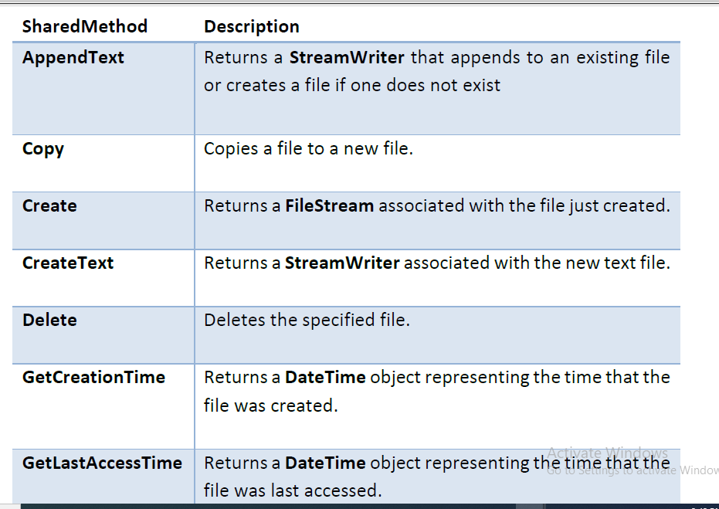
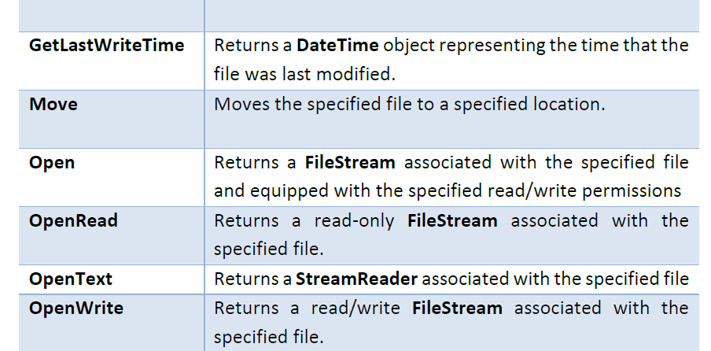
Classes File and Directory

Slide 13
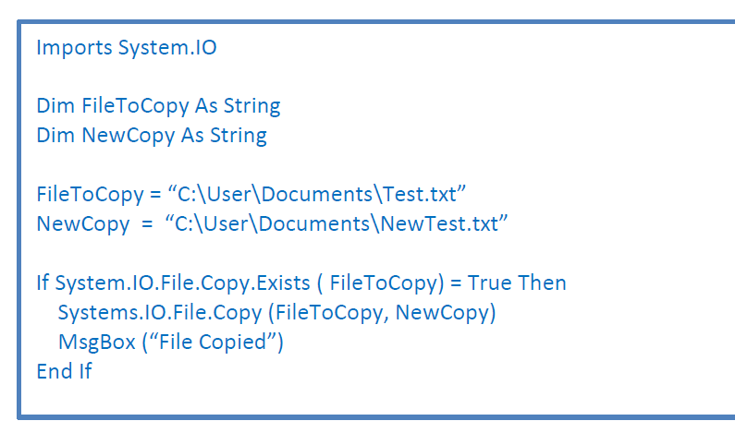
Classes File and Directory
How to Copy a File

Slide 14
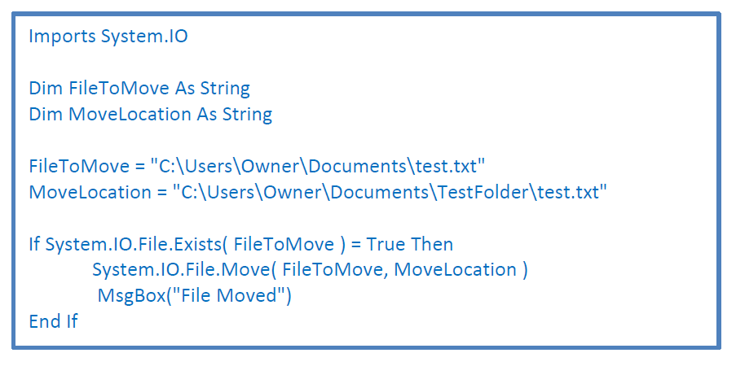
Classes File and Directory
How to Move a File

Slide 15
The end

